Slide 1
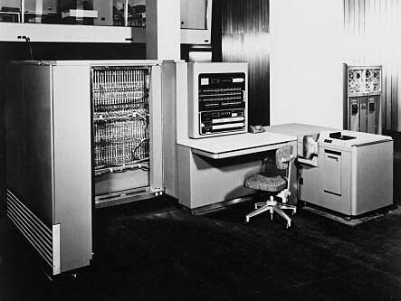
IBM Model 701 (Early 1950's)

Slide 2
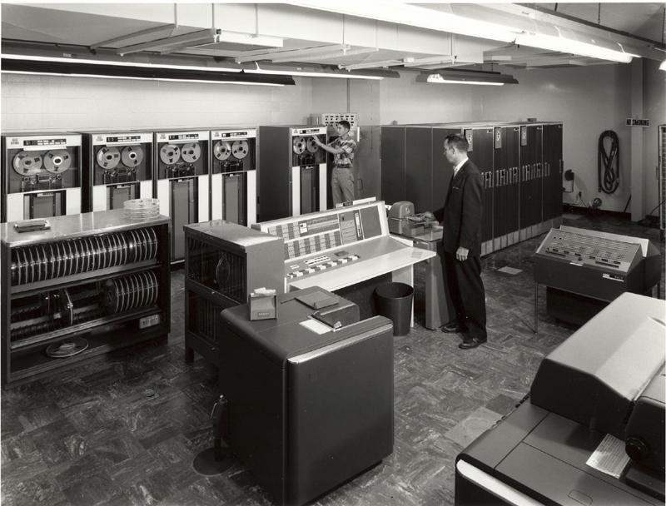
IBM 7094 (Early 1960's)

Slide 3
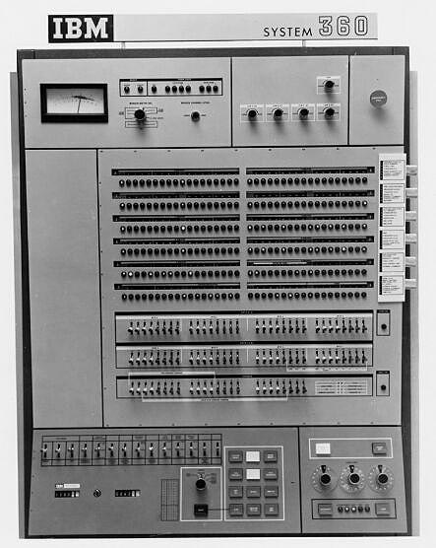
IBM System 360 Console

Slide 5
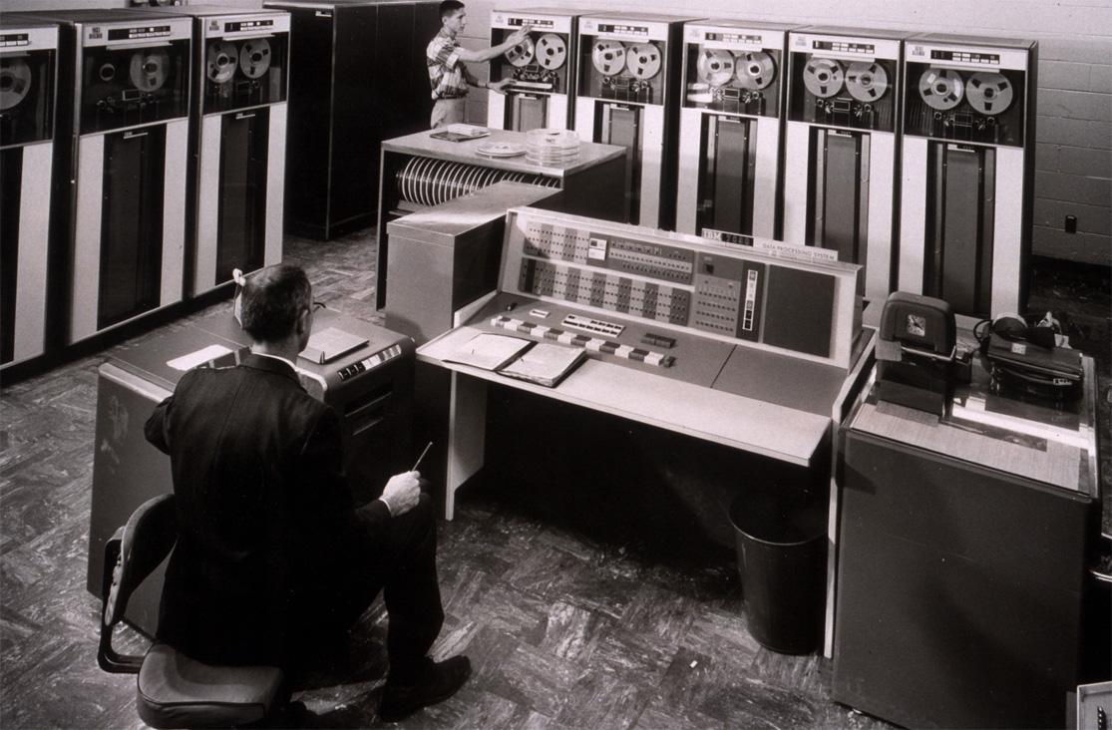
IBM 7094 (Early 1960's)

Slide 6
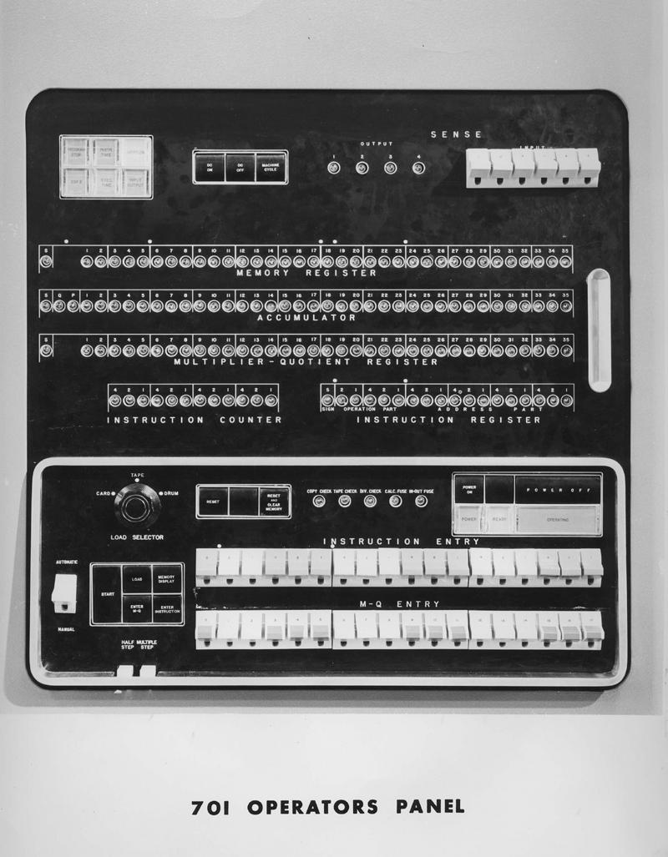
IBM 701 Console

